Slide 1
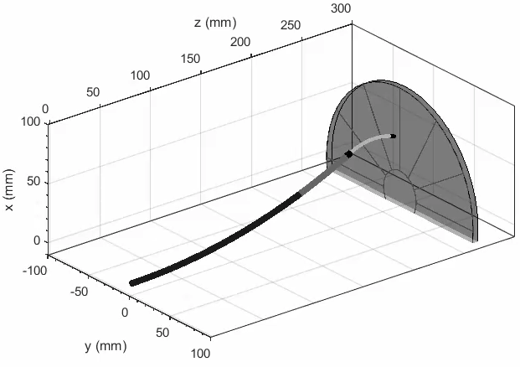
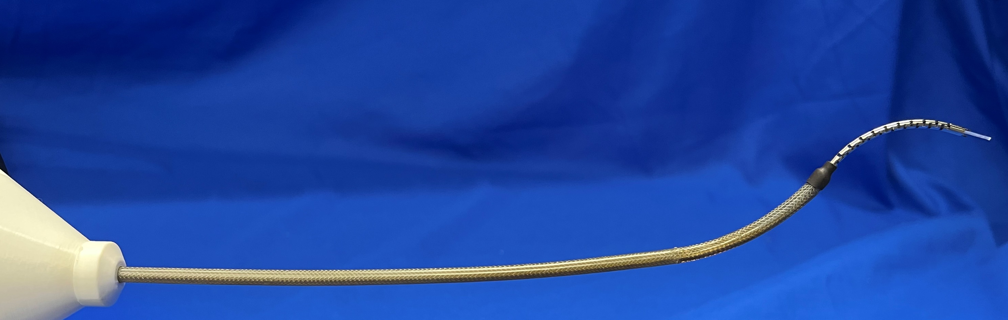
Robot contact model
Real robot prototype
Displacement-driven robot (stiffer?)
Modeled as Cosserat rod (2 section).
Only tip contact.
Calculate speed: ~0.1 s per step.
Simulation - success

Slide 2
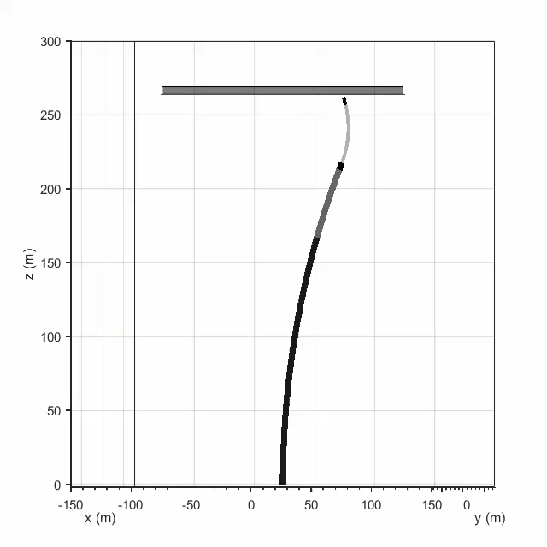
Unstable for larger pushing depth.
(robot instability? FK not solvable)
Simulation - success

